Slide 1
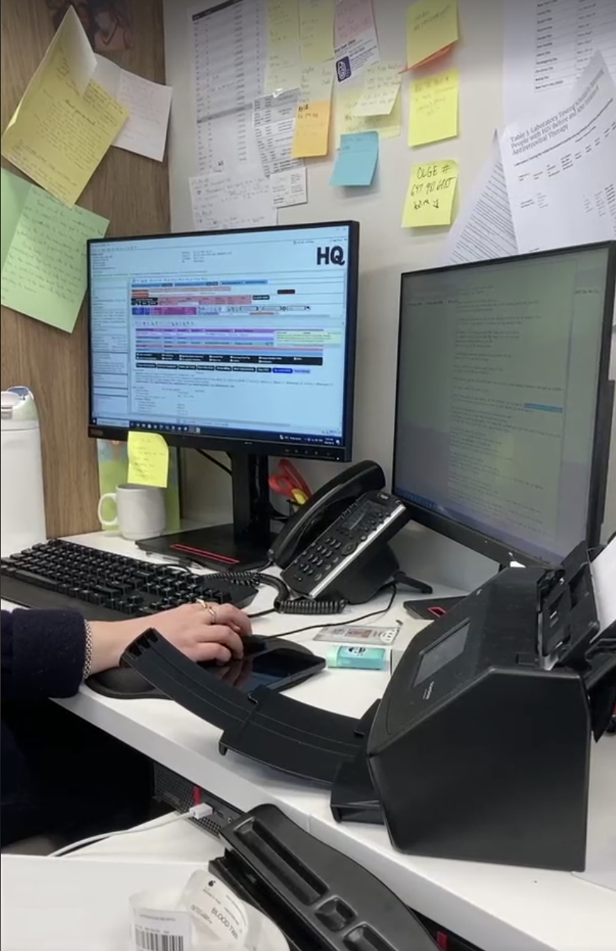
The problem
What is the problem? Tasks nurses spend a lot of time sending negative test results to patients, which could be better used for delivering care to patients. Why is this important? Lead to increased employee burnout Reduced patient care Results not shared quickly Reduced level of patient care

